Slide 1
PROJECT HAZARD
Vibooshan Nanthakumaran
Andrew Johnston
Umer Chaudhri
Klodian Synaj
Muaz Ferati

Slide 2
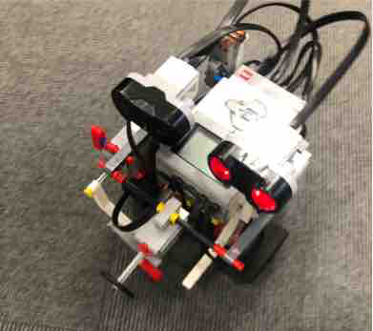
The Purpose
Create an autonomous robot that can:
Play football
Follow an infrared beacon
Detect and avoid obstacles
Stop 40 cm away from goal
Shoot a ball
Score a goal
Notes:
Umer

Slide 3
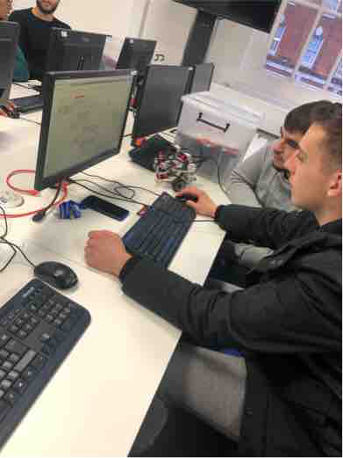
The Process
Research
Scientific properties
Sensor research
Design
Build
Code
Test
Report writing
Presentation
Notes:
andy

Slide 4
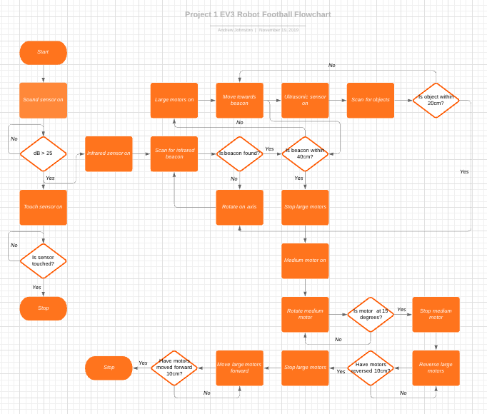

Slide 5
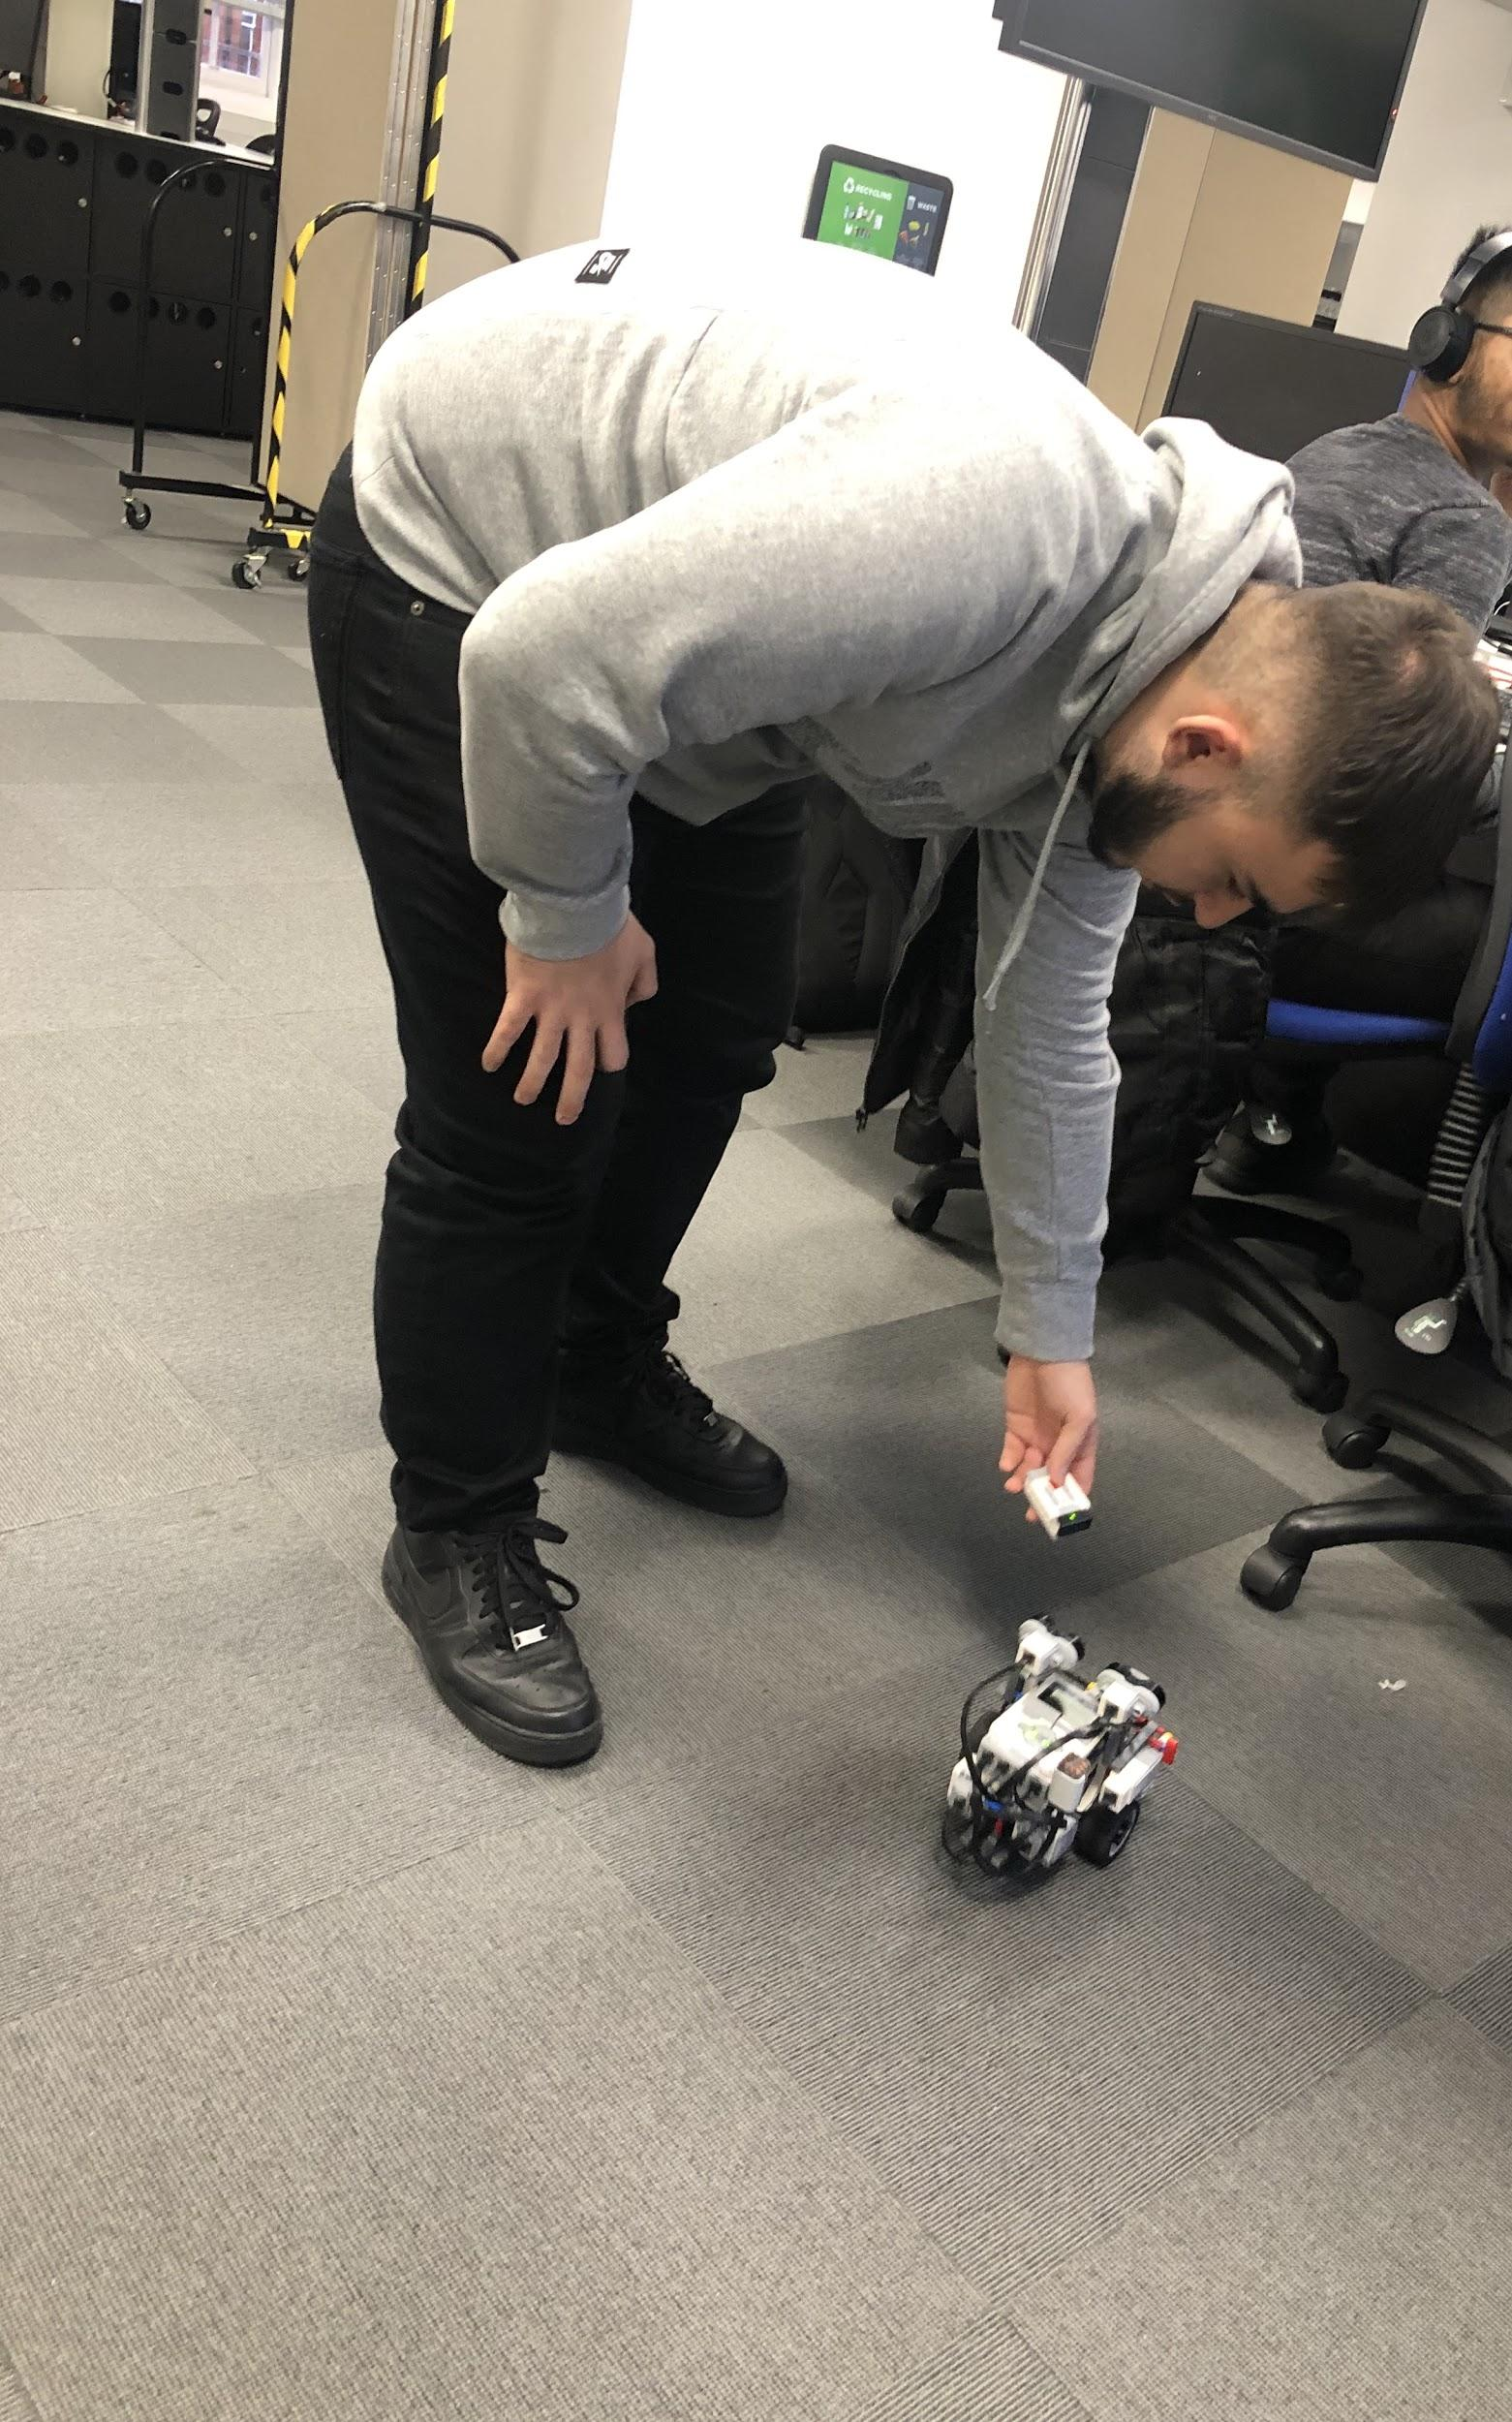
The Hurdles
Too much time on robot
Not enough time to code
Lack of experience
Notes:
Muaz

Slide 6
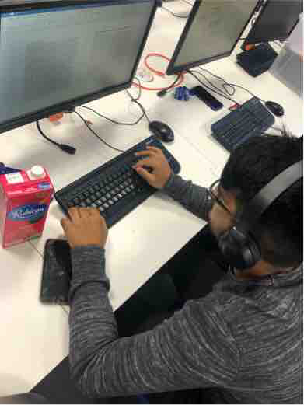
The Lessons
Allocate timing differently
Allocate tolerances
Allocate roles that benefit the team
Notes:
Klodian

Slide 7
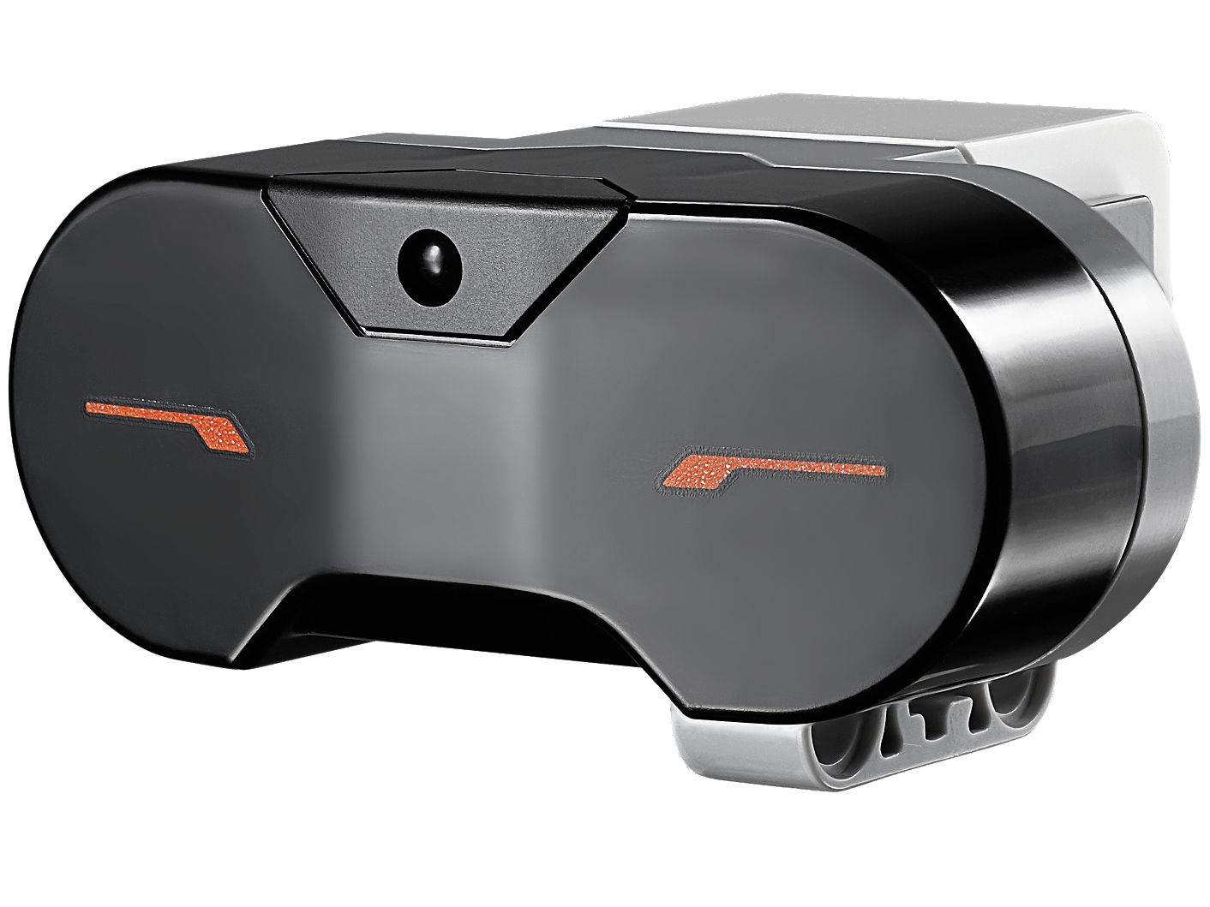
Vibooshan (Project Manager)
Robot research
Sensor research
Robot design
Group report writing
PowerPoint Designer
Figure 1 (Lego 2019)
Notes:
Figure 1- EV3 Infrared Sensor https://www.lego.com/en-us/product/ev3-infrared-sensor-45509 [Accessed 21st November]

Slide 8
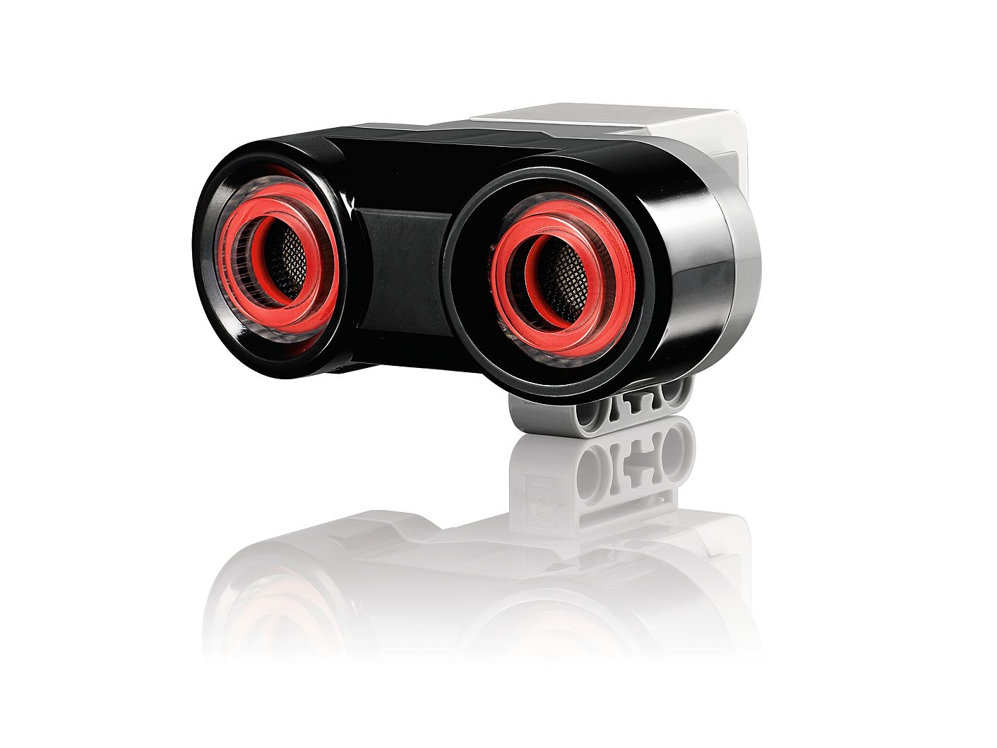
Andrew (Assistant Manager)
Robot research
Scientific properties analysis
Sensor research
Robot design
Robot coding leader
PowerPoint designer
Group report writing
Figure 2 (Lego 2019)
Notes:
Figure 2- Ultrasonic Sensor https://www.lego.com/en-us/product/ev3-ultrasonic-sensor-45504 [Accessed 21st November]

Slide 9
Umer
Robot research
Scientific properties analysis
Robot design
Robot coding
PowerPoint creator
Figure 1 (Lego 2019)

Slide 10
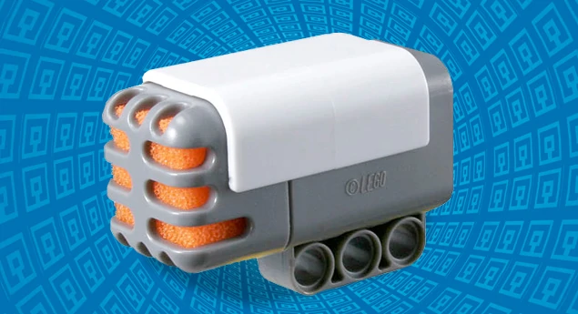
Klodi
Robot research
Sensor research
Robot design
Robot coding
Figure 3 (Lego Fandom 2019)
Notes:
Figure 3 Sound Sensor https://lego.fandom.com/wiki/9845_NXT_Sound_Sensor [Accessed 21st November]

Slide 11
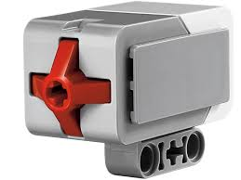
Muaz
Figure 4 (Lego 2019)
Robot research
Sensor research
Robot design
Robot coding
Notes:
Figure 4 https://www.lego.com/en-gb/product/ev3-touch-sensor-45507 [Accessed 21st November]

Slide 12
Any Questions?

